Slide 1
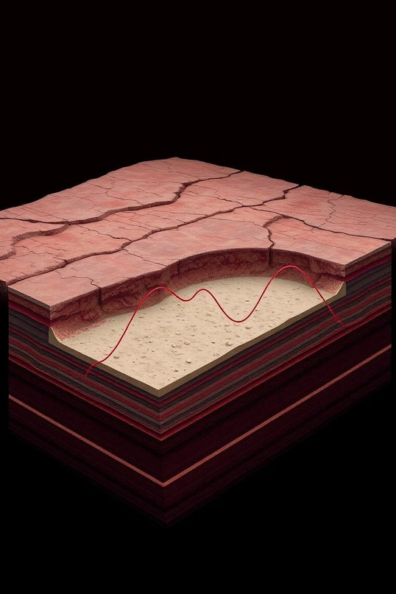


Advancing Subsurface Imaging
This presentation addresses challenges in subsurface imaging, crucial for hydrocarbon exploration and resource management. We will explore current limitations and propose solutions for more accurate velocity predictions.
2 Contributors

Slide 2
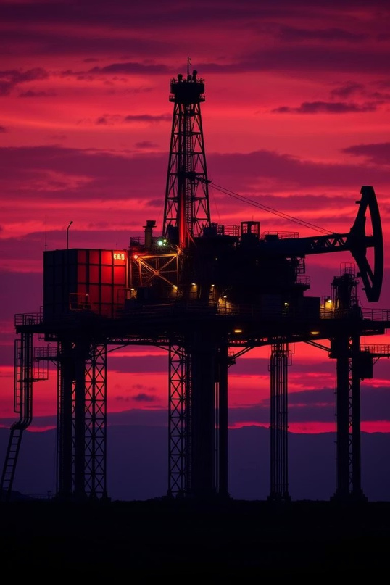
Societal and Economic Impact
Untapped Reserves
Vast hydrocarbon reserves remain untapped, especially in developing economies.
Enhanced Recovery
Enhanced recovery (EOR) and microbial EOR (MEOR) depend on accurate velocity predictions.
Reduced Costs
Better subsurface models reduce dry wells and improve drilling efficiency.

Slide 3
The Challenge: Bridging Theory and Reality
Exploration Failures
Failed exploration in the Sunderban delta highlights a disconnect between theoretical models and real-world success.
Imaging Limitations
Despite robust physical models, subsurface imaging fails due to poor seismic data acquisition and ineffective deep learning generalization.
Model Underperformance
Current CNN-based models underperform on high-noise, low- resolution data. A robust inversion framework is critical.

Slide 4
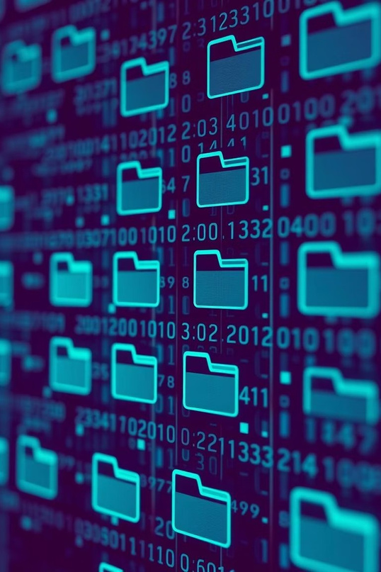
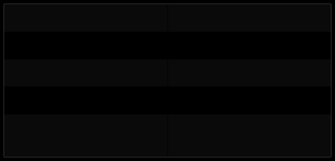
Data Overview
Input Data
File Types Total Files Total Size Task
train_samples/ test/
.npy (NumPy arrays) ~65,859 files ~107 GB Transform seismic waveforms
into velocity maps.

Slide 5
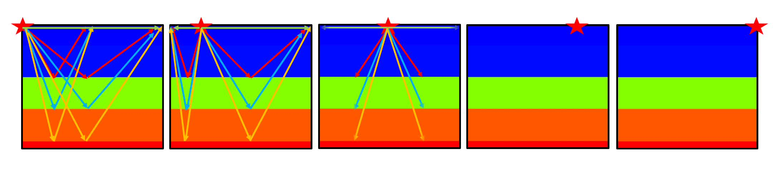
Data Visualization

Slide 6
Data Structure and Output
Input File : Seismic Waves
500 samples, 5 sources, 70 receivers, 1000 timestamps. Shape : 500 * 5 * 70 * 1000
Output File : Velocity Map
500 samples, 70x70 pixels. Shape : 500 * 70 * 70

Slide 7
Current Solution: Enhanced Velocity Prediction
Our advanced solution refines subsurface imaging, providing high accuracy and operational efficiency.
28.4
Mean Absolute Error
45%
Speed Boost
35%
Accuracy Gain
Low error in velocity prediction.
Faster seismic data processing.
Outperforms traditional methods.
A detailed workflow of this innovative approach is available here: Link

Slide 8
Current Bottlenecks
1
High Computational Demand
Waveform inversion models are computationally intensive.
2
Dataset Characteristics
Noisy, varied seismic data requires large training sets.
3
GPU Limitations
Kaggle T4 GPUs have low FLOPS and limited VRAM.

Slide 9
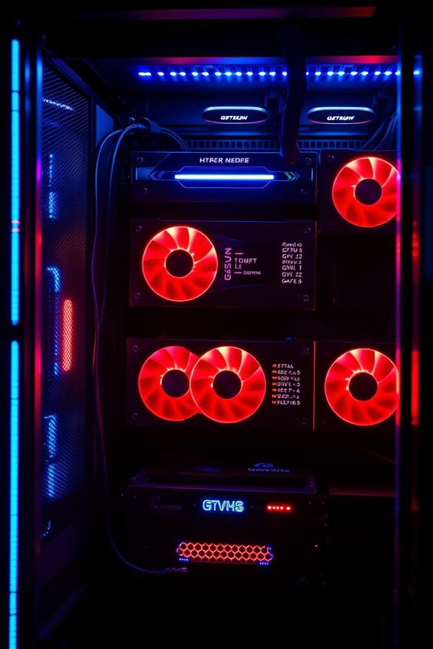
Solution: Multi-GPU Systems
19.5&
80GB
A100 VRAM
Enables larger batch sizes and complex models.
40x
A100 FLOPS
Increased
Experiments
Run more experiments in the same timeframe.
Significantly faster
training per epoch.
Calculation Example: A single A100 (cost $2 an hour) reduces training to 2.4
hours:
With 2 A100s, training time j 1.2 hours.
With 4 A100s, training time j 0.6 hours.
With 8 A100s, training time j 0.3 hours. Benefit: This translates to a 5x to 40x (or more) increase in the number of
experiments.

Slide 10

Future Directions
1
Short-Term
Develop a reference-grade model, publish research, and integrate physics-informed learning.
2
Long-Term
Build an open-source inversion framework and release pretrained models.

